Slide 1
P-values & Hypothesis Testing

Slide 2
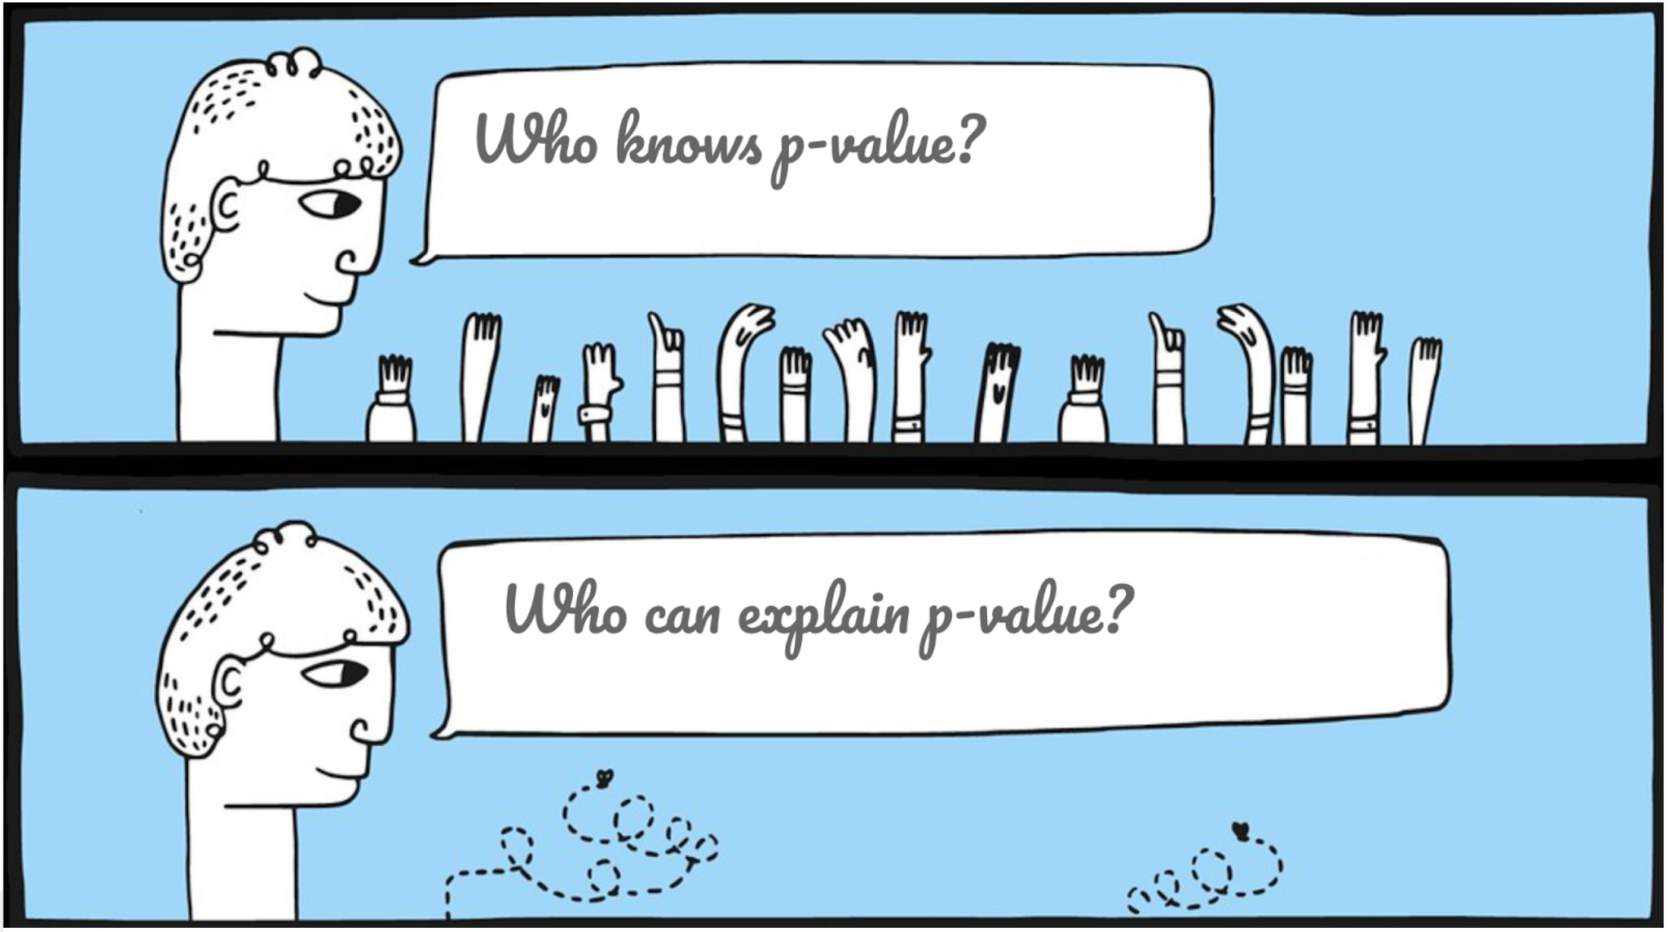
What does a p-value mean to you?

Slide 3

P-values & Hypothesis Testing
Every p-value is associated with a particular null hypothesis.
Hypotheses
Data
Conclusions
A null hypothesis:
States what we do not want to be true
Evidence against the null,
(reject the null, accept the alternative)
An alternative hypothesis:
States what we want to conclude
Is the observed data plausible,
if the null hypothesis is true?
No evidence against the null
(cannot reject the null)
P-value
Probability of observing our data (or something more extreme),
if the null hypothesis is true

Slide 4
Interpreting the strength against the null
“We shall not often be astray if we draw a conventional line at 0.05…”
“If it is below 0.02 it is strongly indicated that the hypothesis fails to account for the whole of the facts”
“If p is between 0.1 and 0.9 there is certainly no reason to suspect the hypothesis tested.”
0
0.1
0.9
1
p-value range
0.05
Quotes from R. Fisher https://www.ncbi.nlm.nih.gov/pmc/articles/PMC2816758/#CR3

Slide 5
Significance level
The significance level defines the cut-off we will apply to the p-value.
It does not have to be 5%
It should be specified a priori
Reject the null
Cannot reject the null
0
0.1
0.9
1
p-value range
0.15

Slide 6

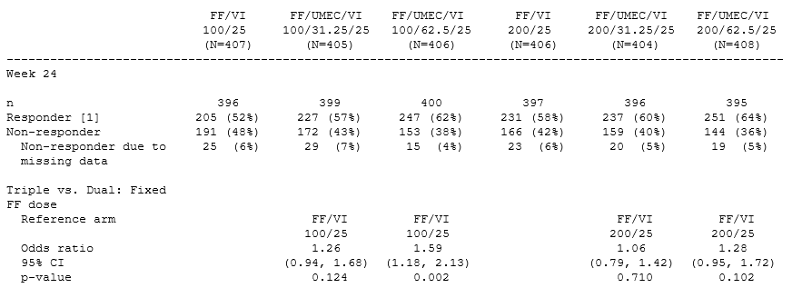
Knowledge Check
Let’s look at an example:
Null hypothesis
No difference in odds between the groups (OR=1)
Alternative hypothesis
There is a difference between the group (OR≠1)
Control
Active
Which statement about the p-value is correct?
The result is statistically significant.
There is a 10% chance of observing OR=1.28 (or more extreme), if the true effect is “no difference”
There is a 10% chance that the true treatment effect is “no difference”.

Slide 7
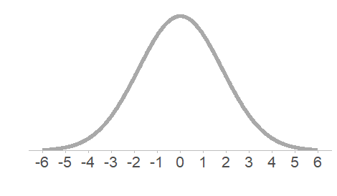
P-values (two-sided)
Visualising a p-value
Definition of a P-value
“Probability of observing our result (or something more extreme), if the null hypothesis is true”
Example (Two-sided test)
Null hypothesis: No treatment difference (difference = 0)
Alternative hypothesis: There is a treatment difference (difference ≠ 0)
Observed difference in means = 3
How likely each observed differences is if the null is true.
Area under the curve represents a probability
Observed difference in means

Slide 8
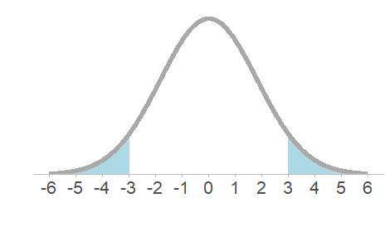
P-values (two-sided)
Visualising a p-value
Definition of a P-value
“Probability of observing our result (or something more extreme), if the null hypothesis is true”
Example (Two-sided test)
Null hypothesis: No treatment difference (difference = 0)
Alternative hypothesis: There is a treatment difference (difference ≠ 0)
Observed difference in means = 3
P-value is 0.102
As extreme as our observed difference
Observed difference in means

Slide 9
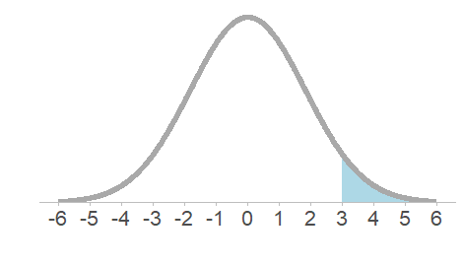
P-values (one-sided)
Visualising a p-value
Definition of a P-value
“Probability of observing our result (or something more extreme), if the null hypothesis is true”
Example (One-sided test)
Null hypothesis: No treatment difference (difference ≤ 0)
Alternative hypothesis: Treatment is better than placebo (difference>0)
Observed difference in means = 3
P-value is 0.051
Observed difference in means

Slide 10
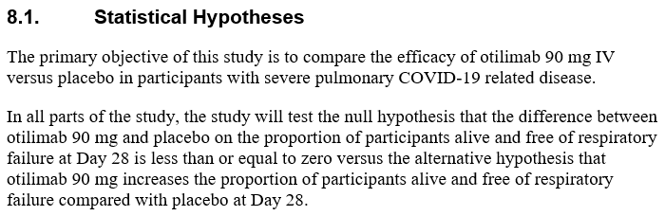
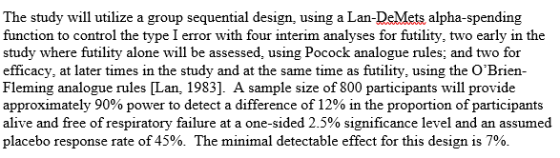
OSCAR Trial (COVID-19)
Is this one or two sided?
One-sided

Slide 11
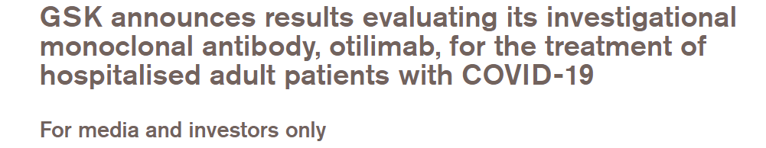
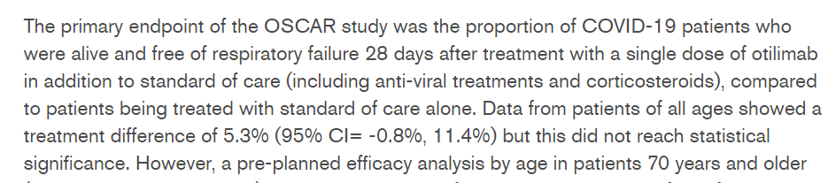
Interpreting the results
GSK announces results evaluating its investigational monoclonal antibody, otilimab, for the treatment of hospitalised adult patients with COVID-19 | GSK

Slide 12
What is the p-value?
Mock output (based on Press Release)
Can we determine what the p-value represents here?
  One-sided
  probability of observing a difference ≥ 5.3% (assuming there is no difference between the groups)
  Two-sided
  probability of observing a difference ≥ 5.3% or ≤ -5.3% (assuming there is no difference between the groups)
Summary and Analysis of Proportion of Participants Alive and Free of Respiratory Failure
 | Placebo (N=xx) | Otilimab 90mg (N=xx)
Number of Subjects with Non-Missing Data at Timepoint | xx | xx
Alive and Free of Respiratory Failure, n (%) | xx (xx%) | xx (xx%)
Model Adjusted Proportions
Otilimab vs. Placebo (Model Adjusted)
Difference in Proportions | 5.3
95% Confidence Interval | (-0.8, 11.4)
p-value | 0.03
Note: Analysis performed using logistic regression adjusting for treatment, age group and clinical status at baseline

Slide 13
What is the p-value?
Mock output (based on Press Release)
Summary and Analysis of Proportion of Participants Alive and Free of Respiratory Failure
 | Placebo (N=xx) | Otilimab 90mg (N=xx)
Number of Subjects with Non-Missing Data at Timepoint | xx | xx
Alive and Free of Respiratory Failure, n (%) | xx (xx%) | xx (xx%)
Model Adjusted Proportions
Otilimab vs. Placebo (Model Adjusted)
Difference in Proportions | 5.3
95% Confidence Interval | (-0.8, 11.4)
p-value (one-sided) | 0.03
p-value (two-sided) | 0.06
The result is not statistically significant as the one-sided p-value is above the set significance level of 2.5%
Note: Analysis performed using logistic regression adjusting for treatment, age group and clinical status at baseline

Slide 14
Knowledge Check
What does the p-value tell us?
A GSK trial was designed to test a new GSK treatment against the standard of care (using two-sided 5% level). The trial reported it had achieved a statistically significant result for its primary analysis, with p=0.02.
  What do we know?
  GSK treatment is superior to standard of care
  There is no difference between the two treatment groups
  The observed data is very unlikely, if the null hypothesis (no difference between the groups) is true
  We cannot say anything

Slide 15
Key Messages
Hypothesis testing and p-values
What do you need to do?
Hypothesis tests use observed data to determine if a hypothesis (null) is plausible.
Consider what null hypothesis and significance level are being used to help you interpret the finding.
Do not present p-values in isolation.
A p-value is a measure of this plausibility.
P-values alone do not show the direction of effect.
Can your statistician help ensure results are communicated clearly?

